Slide 1
Data upload to the Brassica Information Portal
Workshop- uploading population and trial scoring data
Wiktor JurkowsKi, Carlos Horro, Annemarie ECKES
Integrative Genomics, EI & Elixir UK
Notes:
We are developing the Brassica Information Portal as a resource that collects, integrates and analyses phenotypic data from pre-breeding experiments on Brassica crop species.
The Portal will facilitate Brassica crop breeding with a data-driven approach: The data collected from phenotyping experiments are made accessible and available in a standardised manner. This data can be integrated with genotypic information. In the future, associative analysis tools will enable on the fly analysis between traits hosted in the Portal and external genotypic information.

Slide 2
Workshop plan
Introduction
Lecture 1: BIP (Wiktor)
Introduction to hands-on
Download workshop material
Plant Population submission
Presentation of data sets (toy examples)
Individual work with manual
Coffee break
Data standards presentation (Carlos)
Trait data submission
Presentation of data sets (toy examples)
Individual work with manual
Parallel sessions
BYOD workshop
Discussion of population types
Discussion of BIP mapping to MIAPPE
Notes:
Reminder about own data. How many data sets?

Slide 3

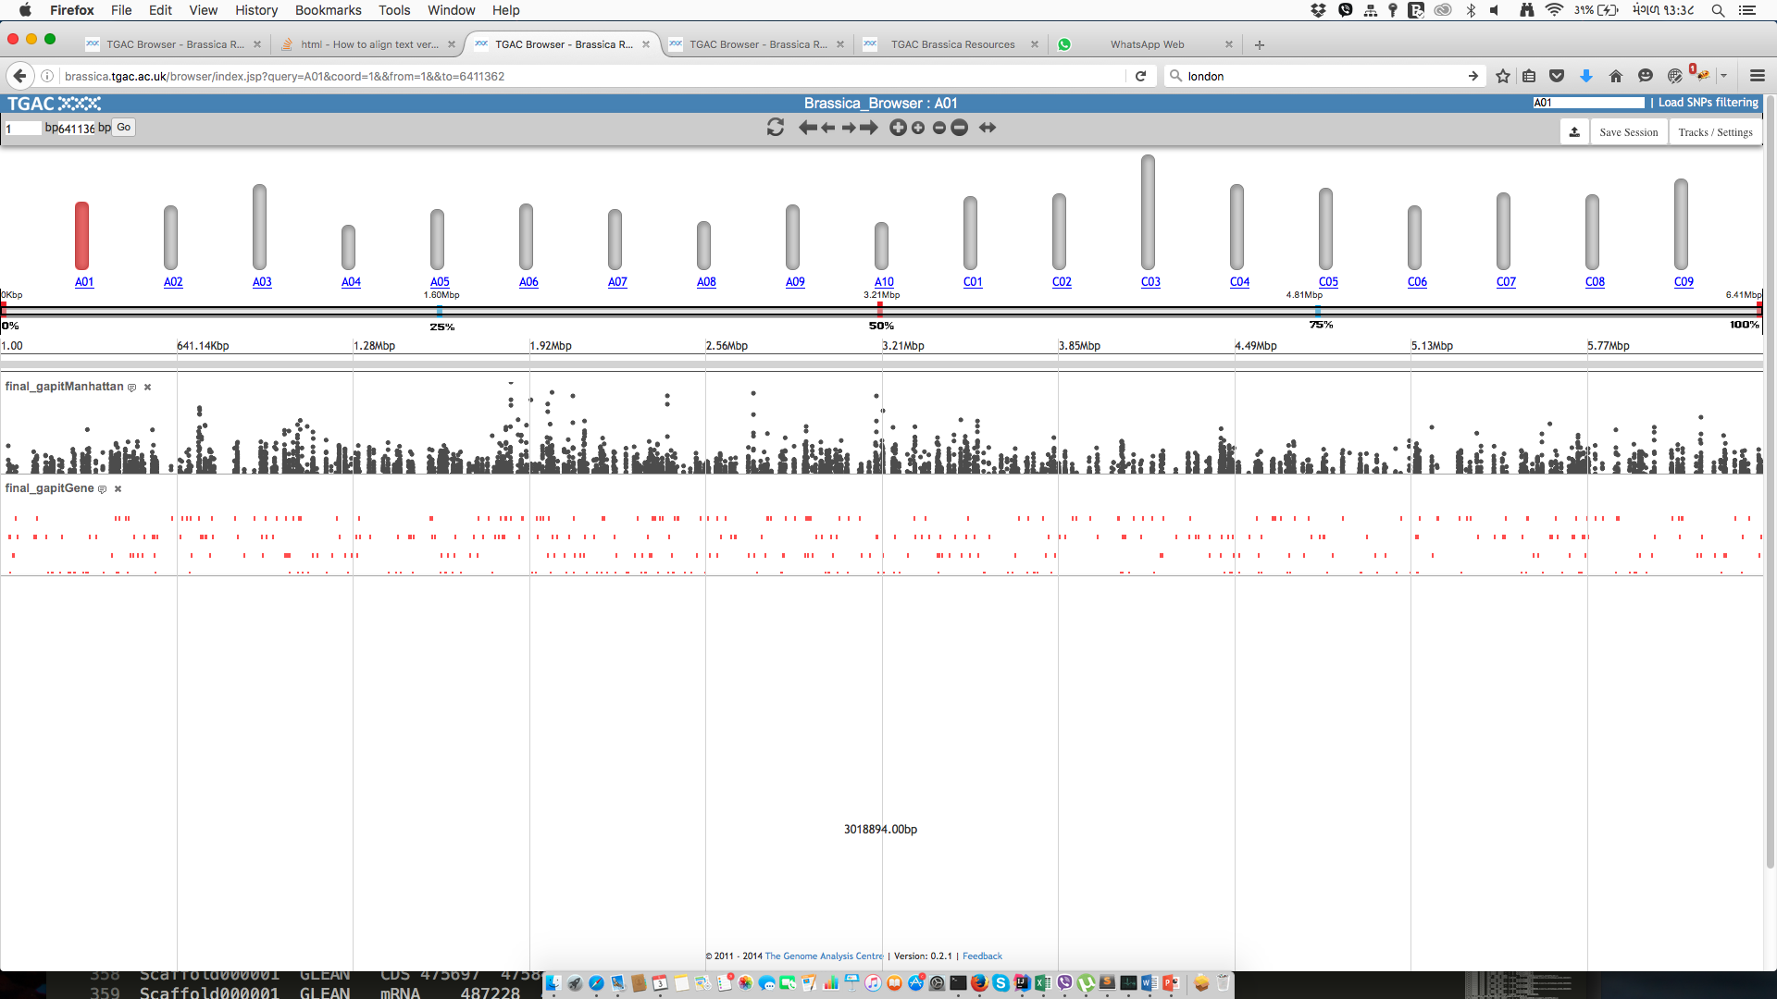
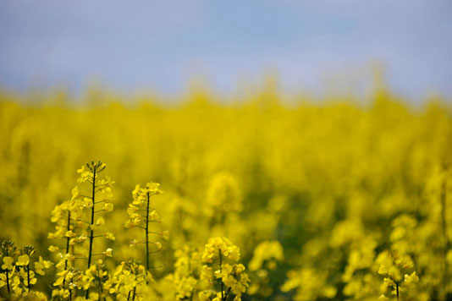

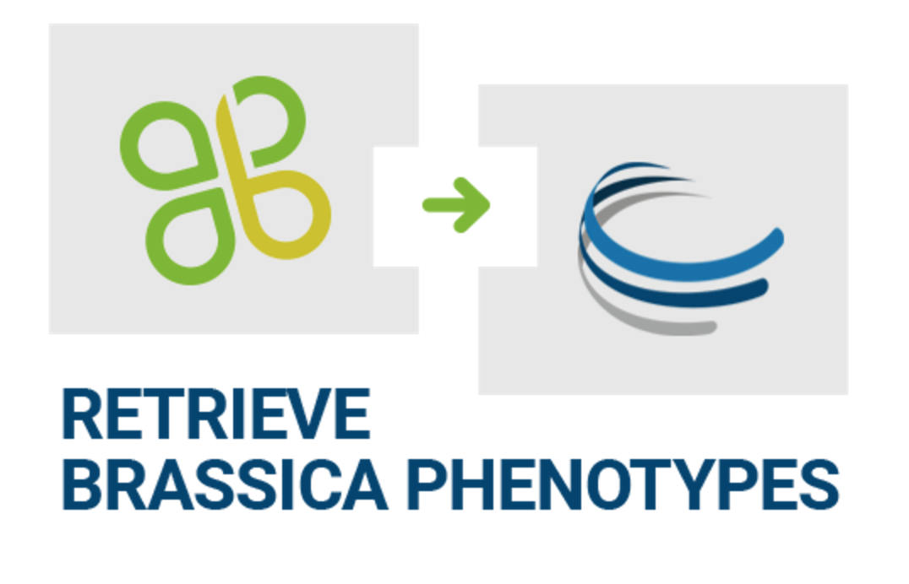
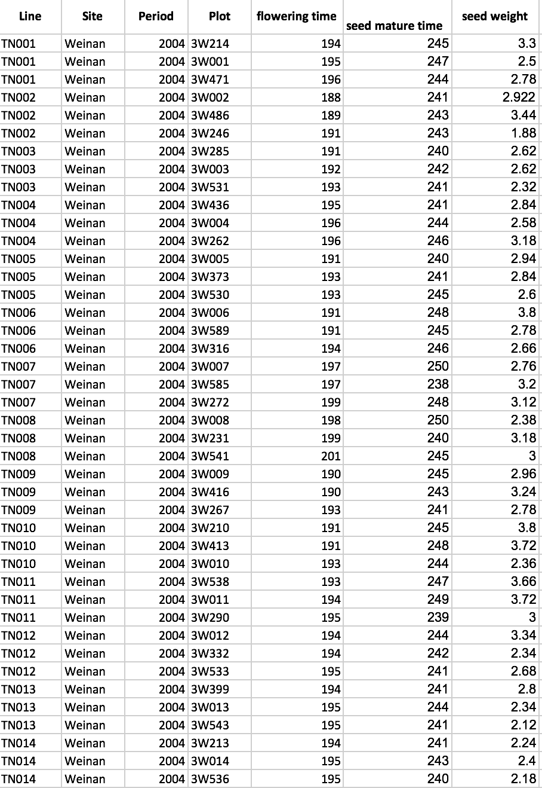
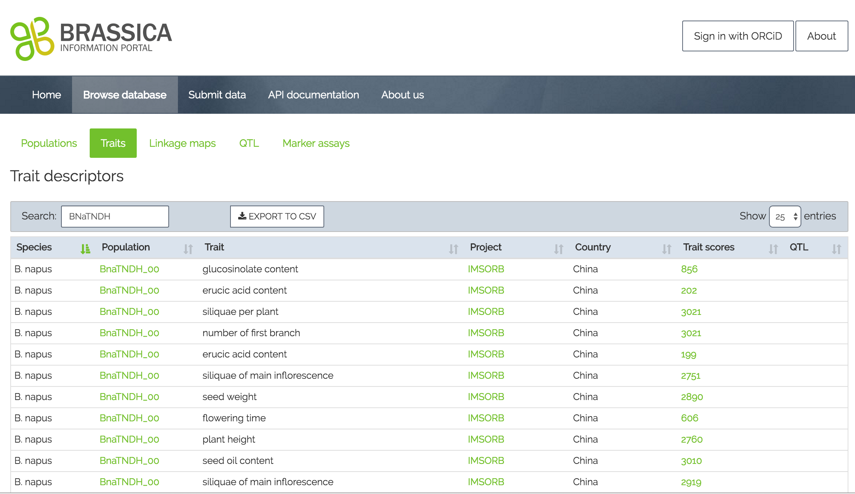


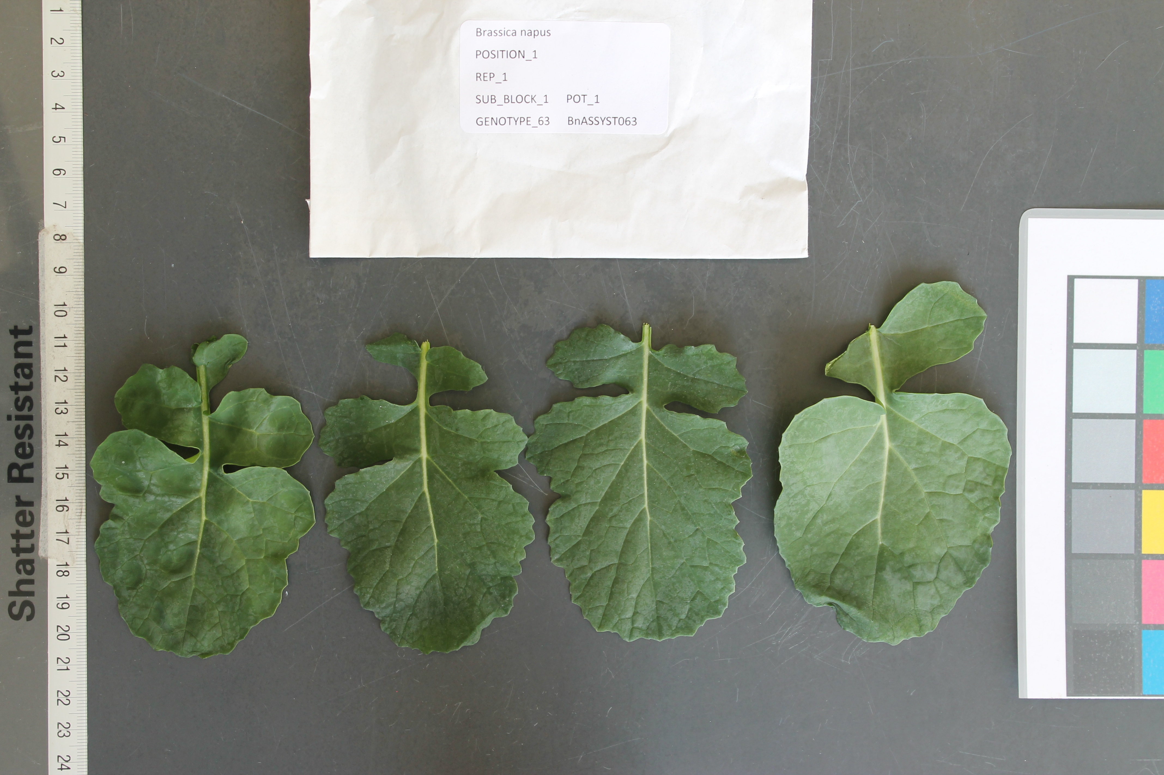
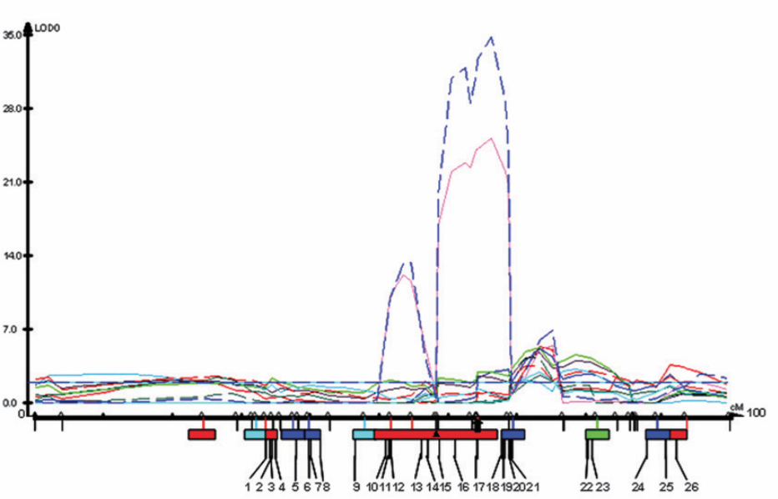



BIP integration with other resources
Extended submission, cross-linking, analysis, publishing
Notes:
The original “direction”/way of Using the BIP is linear: Data can be stored and accessed for downstream analysis. It is simply a “repository” of trait scoring data for Brassica crops.
But we are working on extending and cross-linking its functions, some of which I will present later. For example, we have made it possible to submit image names and draw from CyVerse as a default resource to cross-link the image names submitted to BIP.
Extension: make user submit image data alongside with measurements. The images will automatically be stored in CyVerse as opposed to the user having to do this manually.
The user can now submit sequence identifiers from SRA with the submission, which are automatically cross-linked with the corresponding entry in NCBI.
It is now possible to access the BIP via the TGAC browser. The feature allowing this is dependent on background data uploaded to the Browser by the administrator.
In the background of the brower, SNP information for the RIPR population is loaded. People interested can select lines carrying certain SNPs of interest and compare them with lines not carrying these SNPs. During this analysis, the user can look up the line in the Brassica Information Portal and see any related information about the line there ( e.g. registered trait measurements, origin, Cultivar name, all experiments using that line, etc.., )
-Note that this feature is currently only accessible as a service for the RIPR project, as it is sensitive data.
Legacy data sequences- where possible are cross-linked with Ensembl/ NCBI.
One can now obtain DOIs for datasets submitted to easily BIP to cite them in publications.
We are working with the CyVerse team to integrate their analytics tools with the BIP.
The first step is realised: using Retrieve brassica Phenotypes, one can download data from BIP into CyVerse for subsequent analysis.
In Beta version, we have a local Association analysis tool, called GWASSER, developed by Ben Ward, there will be more about this particular tool later.

Slide 4

The Brassica Information Portal in the Research Cycle
Identify pot. collaborators
Meta analysis of data content
Research question
Finding communication
Study design
Get inspired by existing studies
Perform associative analysis with cross-linked genotypic information
Define and submit the traits
( new Ontology terms)
Data analysis
Data collection
Data submission
Perform on-the-fly statistical analysis of phenotypic raw data and compare with existing studies
Have metadata and trait data ready
Notes:
All possible interactions the Brassica Information Portal can have with the Research Cycle in plant breeding research.
The Portal can be integrated in all aspects of Brassica research from generating a research question and collaborations from selecting or defining new traits to measure, through data handling and storage to associative analysis.
Also a summary slide for what I have done and future developments.

Slide 5
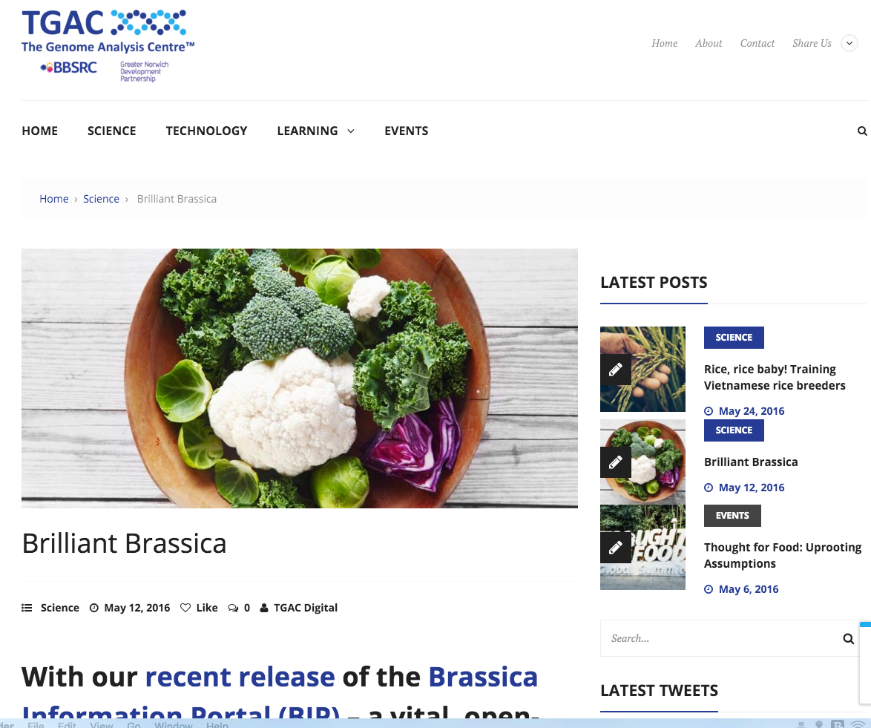
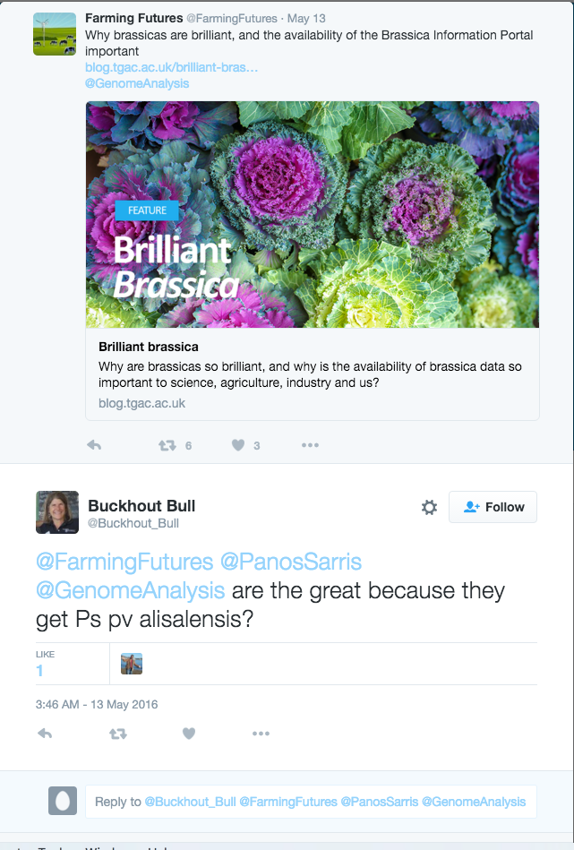
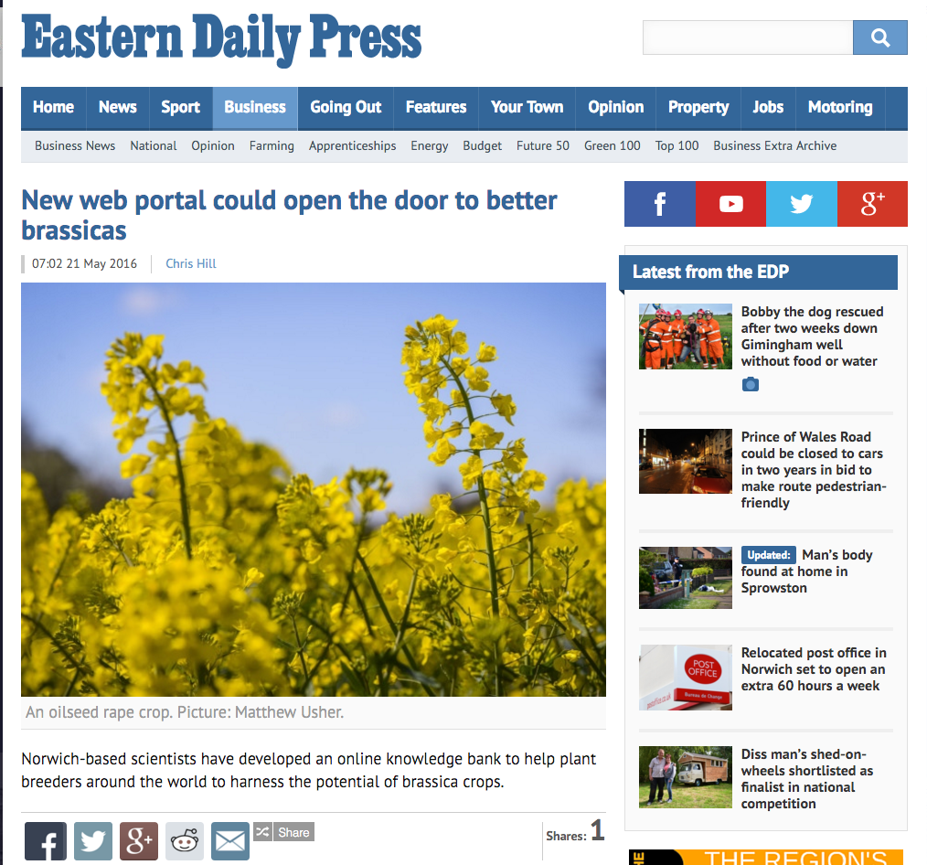
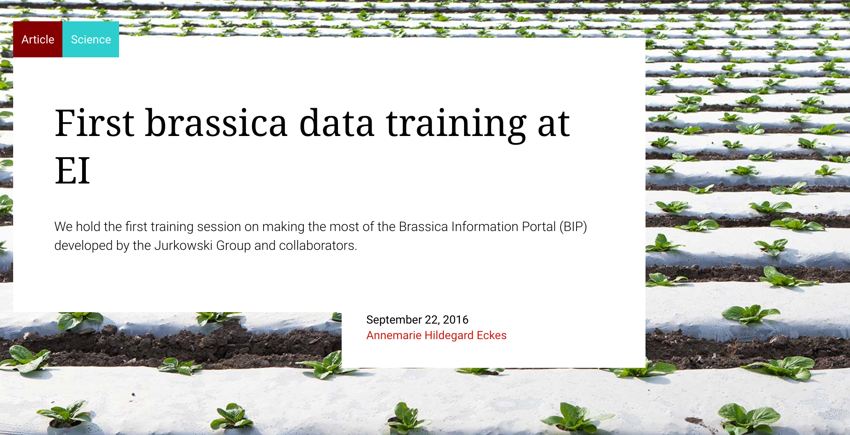
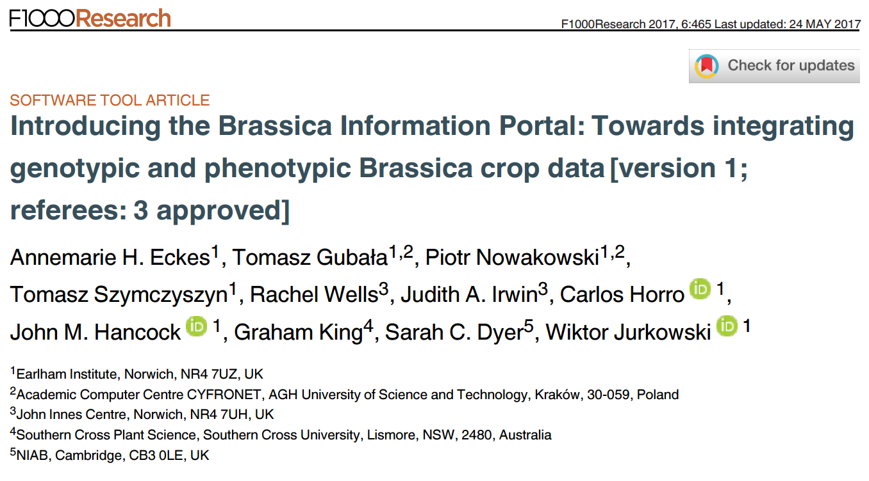
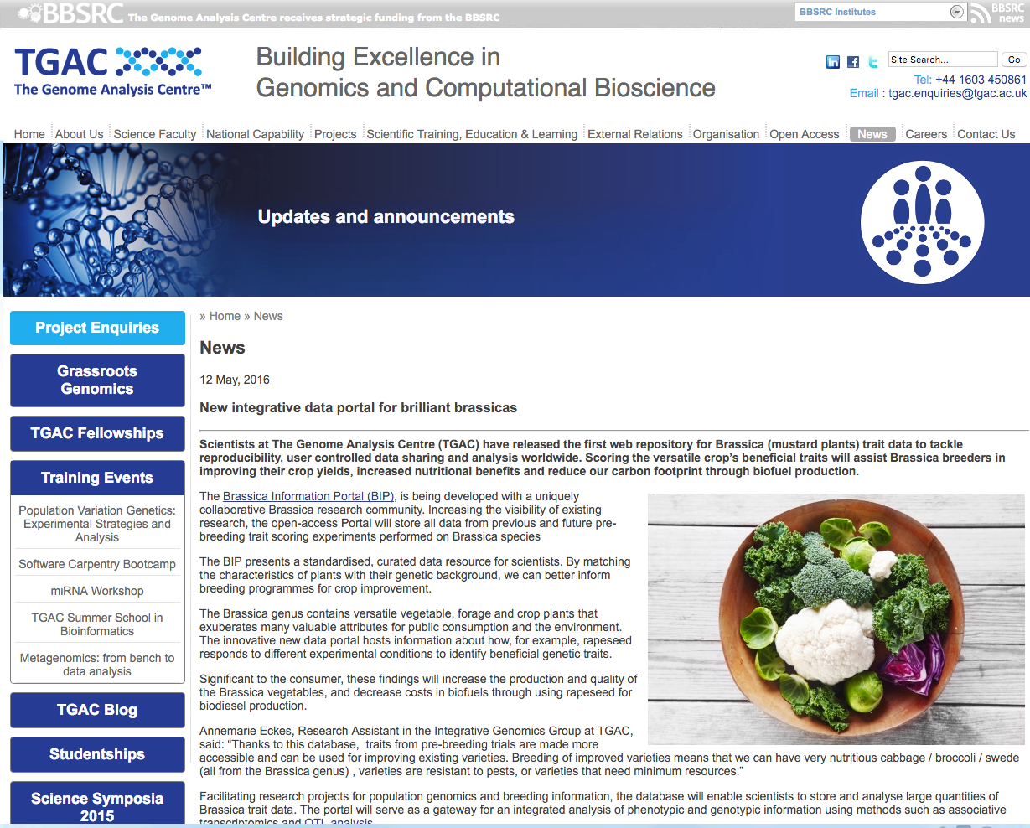

in the media

Slide 6
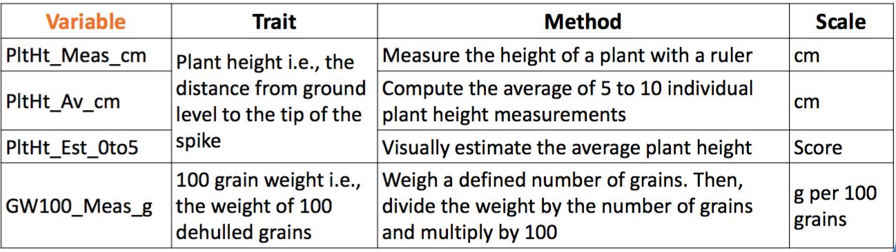

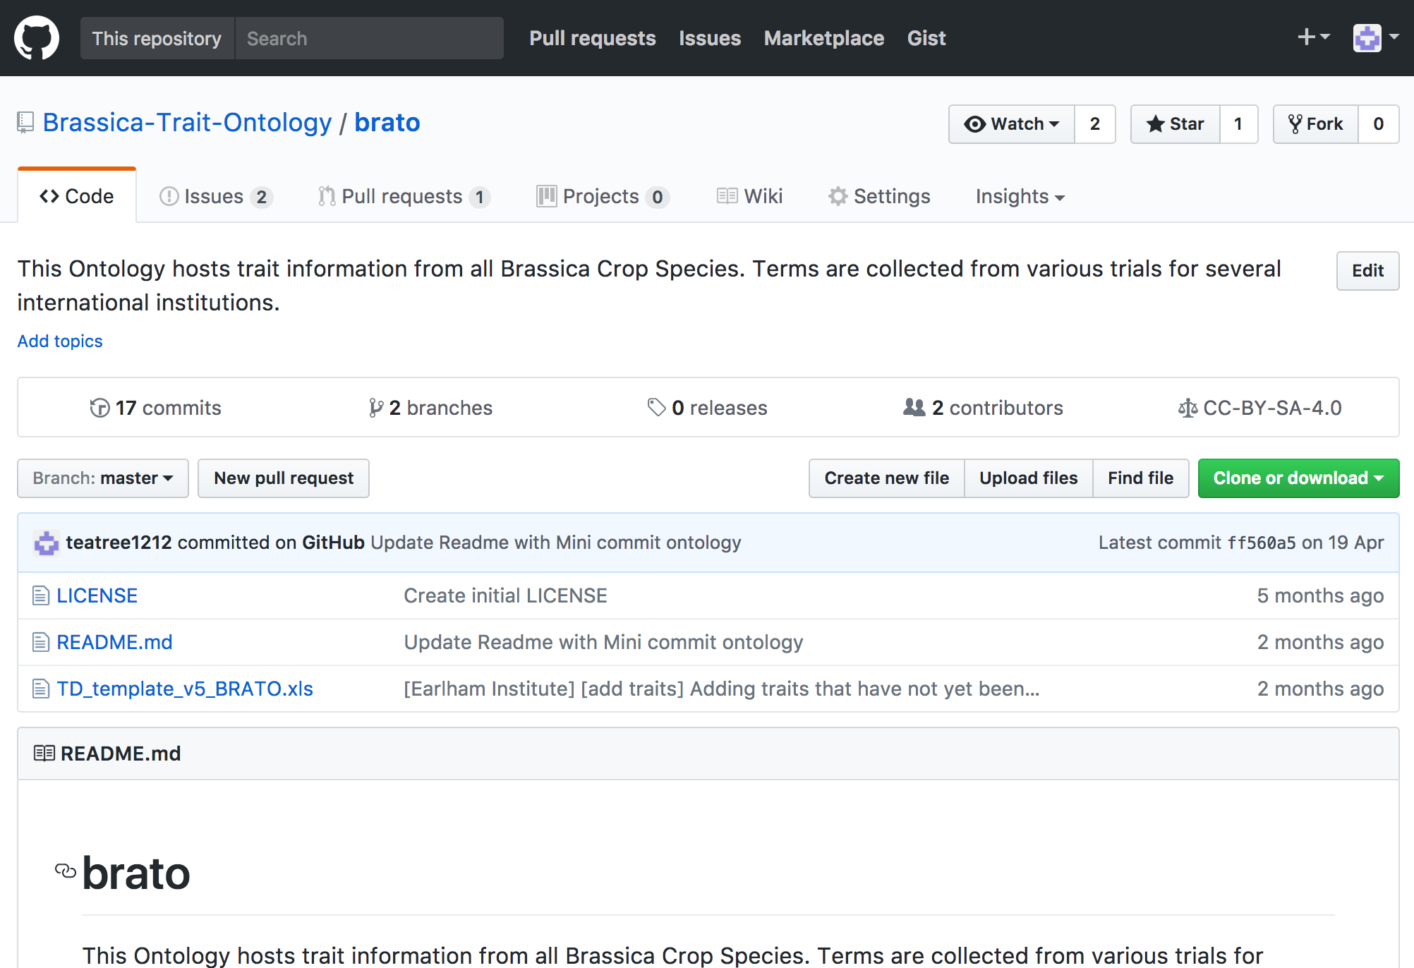
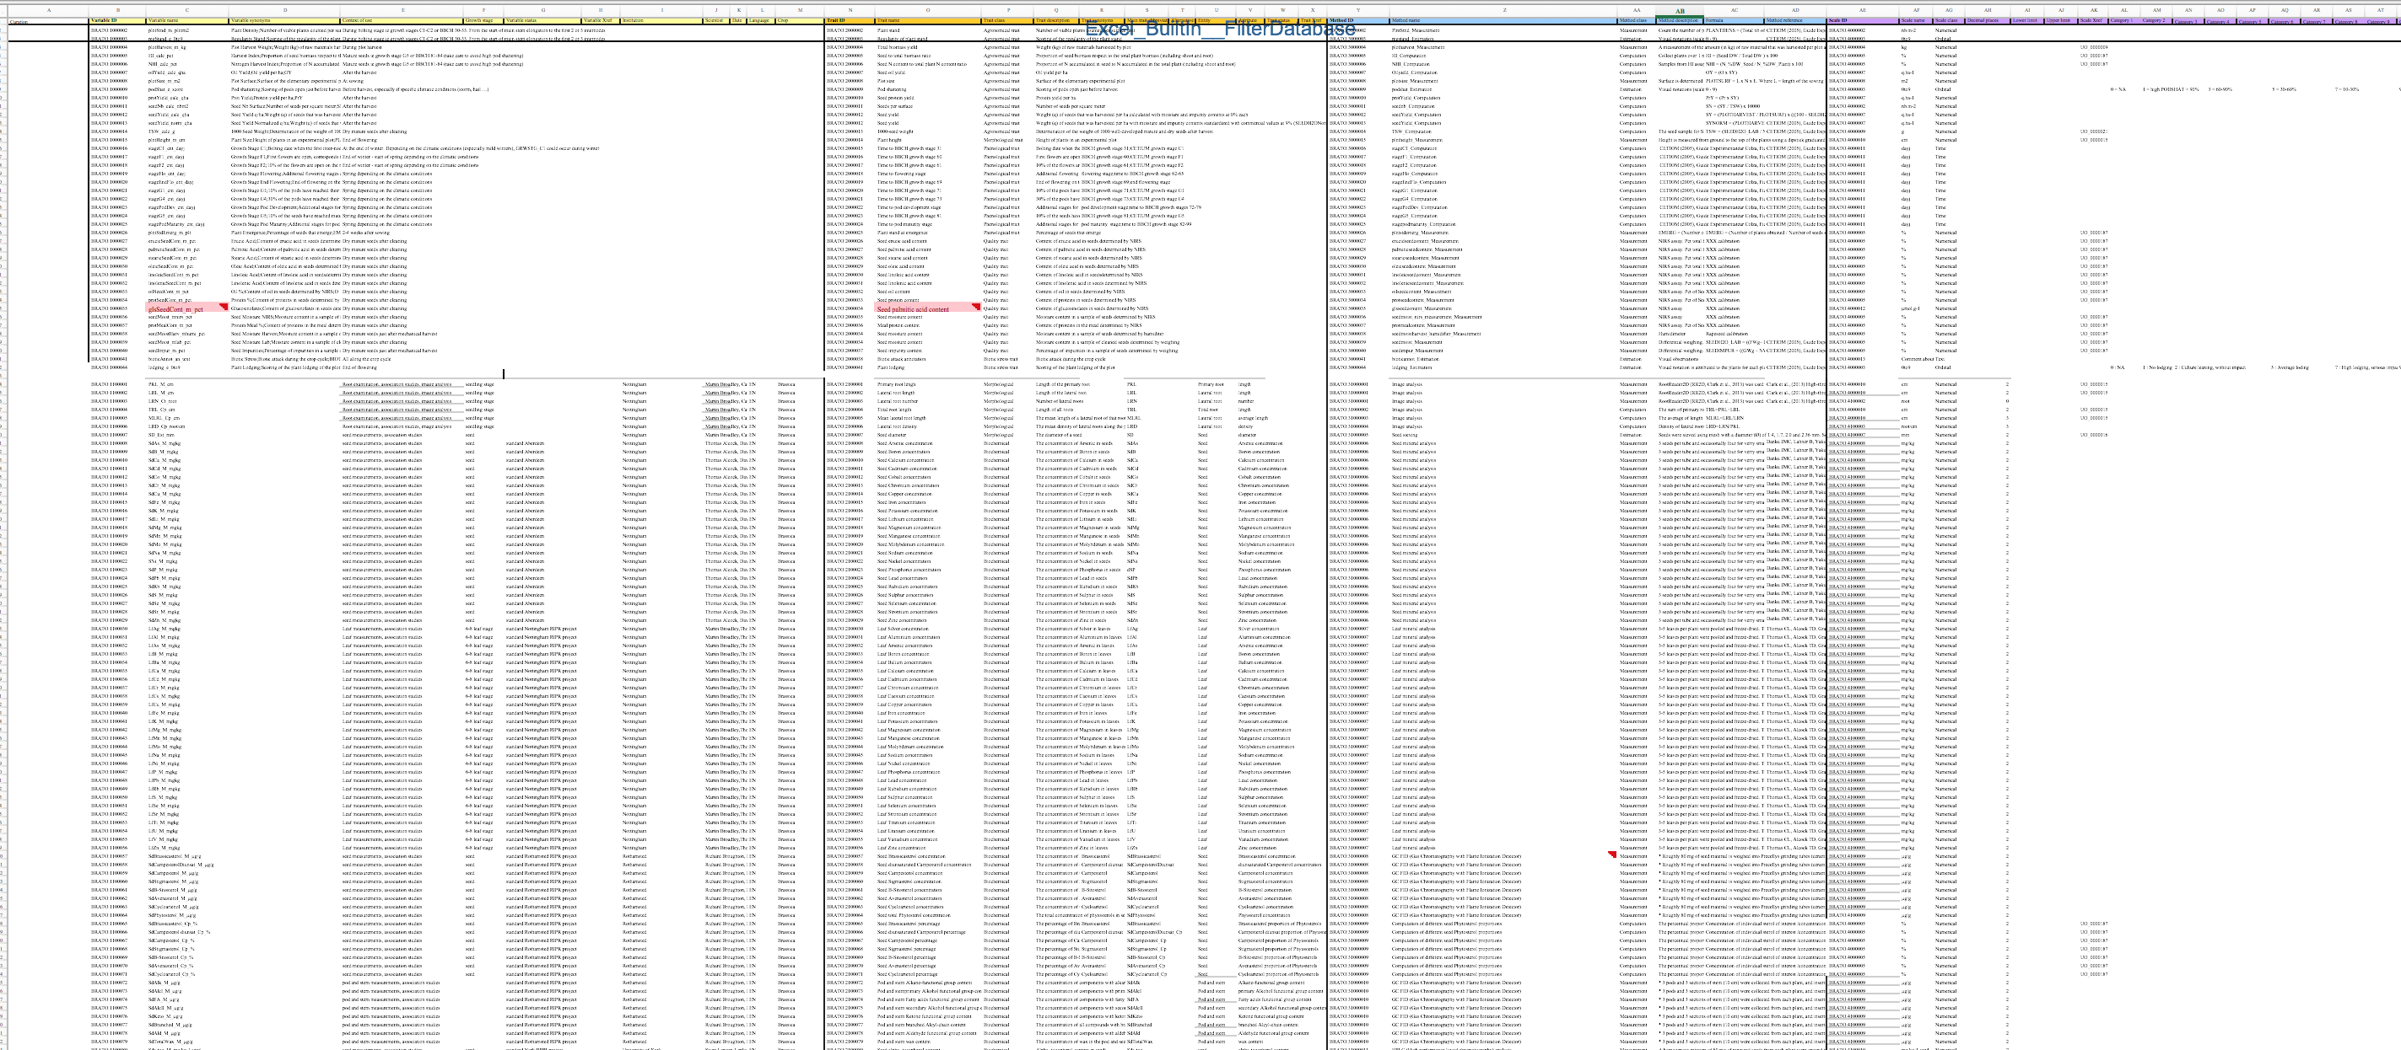
Standardisation and integration efforts
BRATO- Brassica Trait Ontology
167 Traits defined – any more traits ??

Slide 7
BIP integration with CyVerse
http://cyverseuk.org/applications/by-earlham-institute/retrieve-brassica-phenotypes/
Notes:
The app “Retrieve-Brassica-Phenotypes” imports standardised Brassica trait data from the Brassica Information Portal (BIP) into CyVerse, so that the user can subsequently integrate this data into genotype-phenotype association analysis worflows.
CyVerse has a documented variant calling workflow: https://pods.iplantcollaborative.org/wiki/display/~luj/Variant+Calling+Workflow
CyVerse has some tools that help in the Association analysis workflow, but this is not yet properly documented, some tools are available in the discovery environment: https://pods.iplantcollaborative.org/wiki/display/Events/GWAS+-+MLM.
So this is still under construction, but you can try things out in the discovery environment, it is certainly helpful, as you get all the computing power for freeeee..

Slide 8
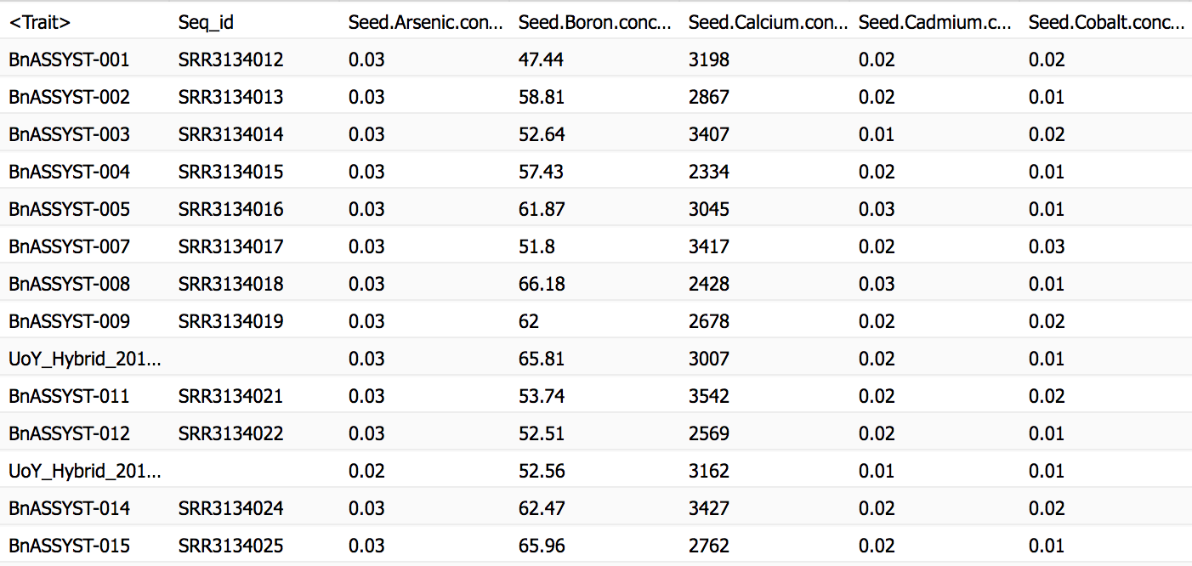
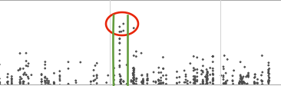
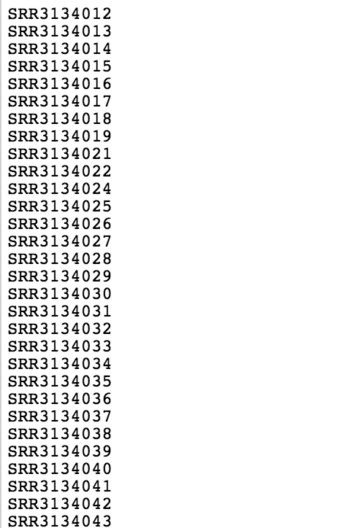
BIP integration with CyVerse
http://cyverseuk.org/applications/by-earlham-institute/retrieve-brassica-phenotypes/
Trial_name
Api_kei
-log 10P
Location on Sequence
Variant Calling Workflow
Notes:
The app “Retrieve-Brassica-Phenotypes” imports standardised Brassica trait data from the Brassica Information Portal (BIP) into CyVerse, so that the user can subsequently integrate this data into genotype-phenotype association analysis worflows.
CyVerse has a documented variant calling workflow: https://pods.iplantcollaborative.org/wiki/display/~luj/Variant+Calling+Workflow
CyVerse has some tools that help in the Association analysis workflow, but this is not yet properly documented, some tools are available in the discovery environment: https://pods.iplantcollaborative.org/wiki/display/Events/GWAS+-+MLM.
So this is still under construction, but you can try things out in the discovery environment, it is certainly helpful, as you get all the computing power for freeeee..

Slide 9
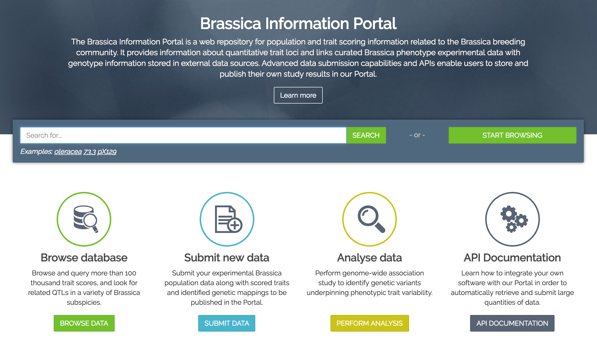
In-house on the fly association analysis
GWAS analysis in R/JavaScript
Based on GWASSER R package (Ben Ward, Matt Clark)
Upload genotype data in VCF or CSV format
Results of analysis saved in user panel and stays private at all times
Spreadsheet download
Manhattan plot

Slide 10
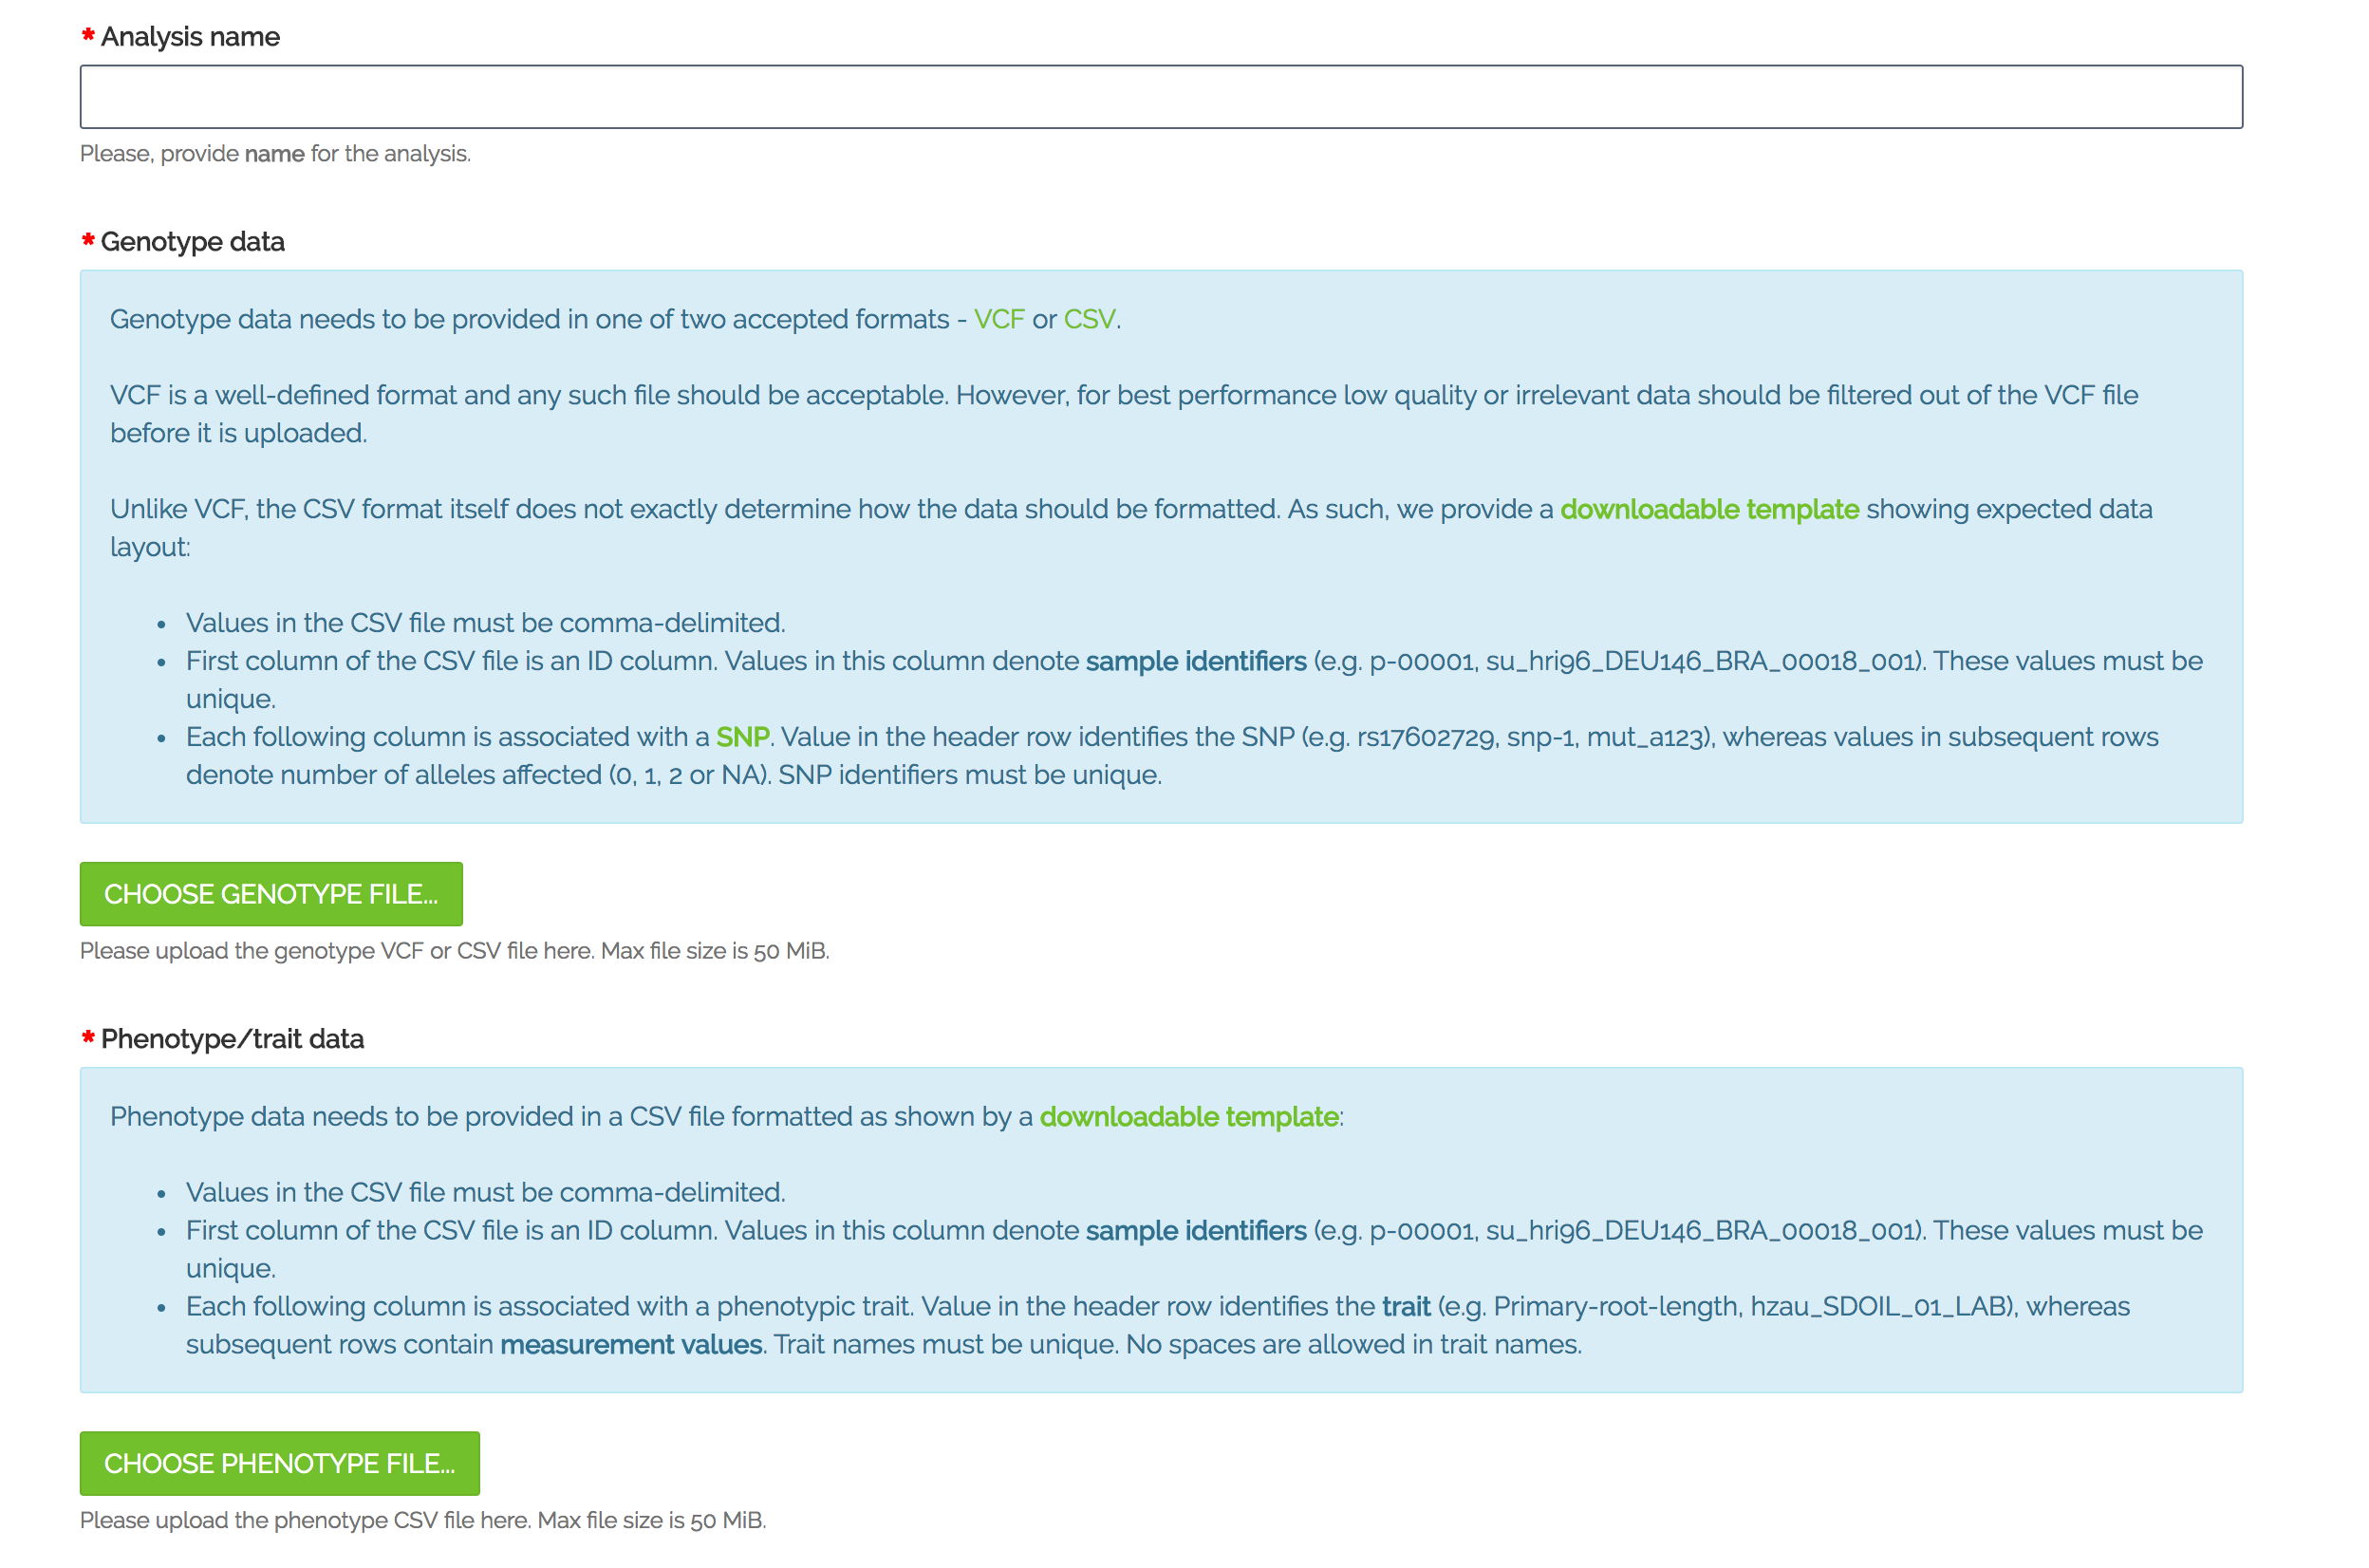

Slide 11
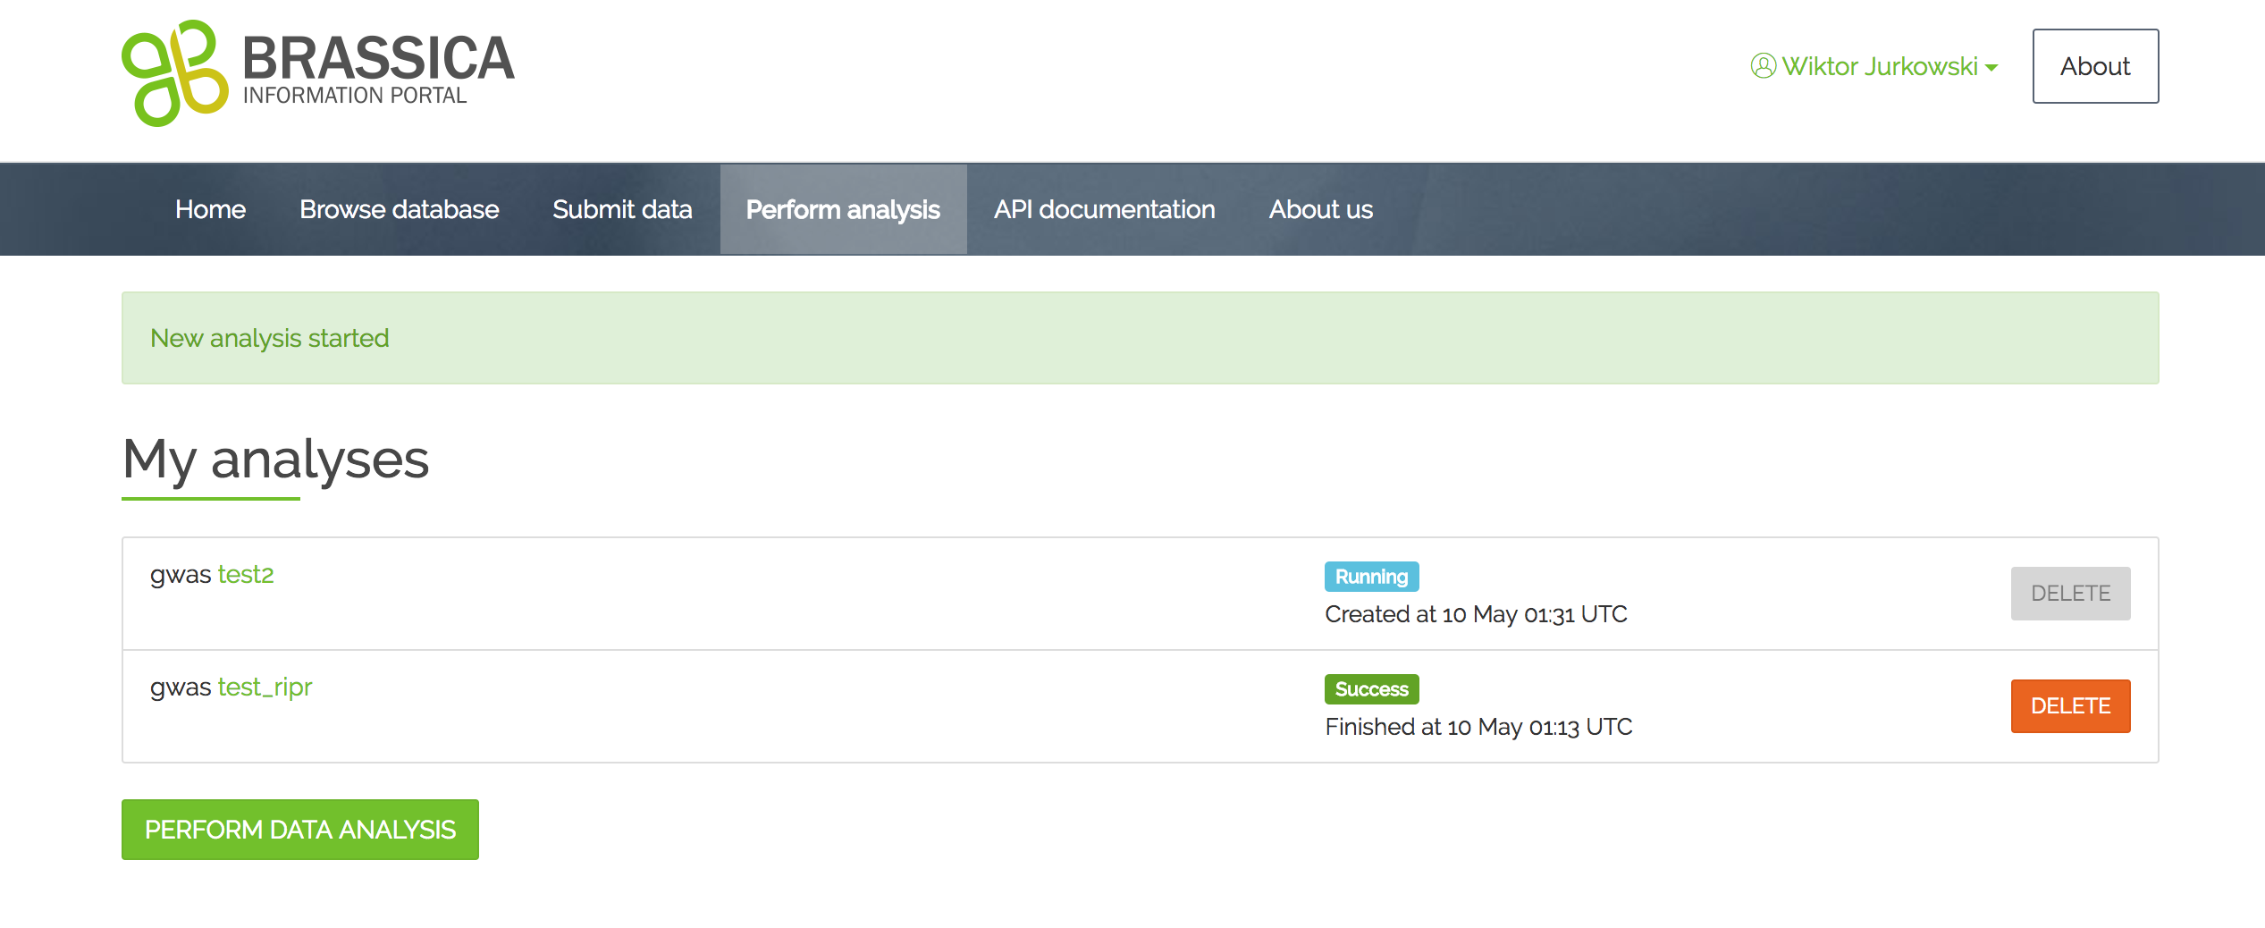

Slide 12
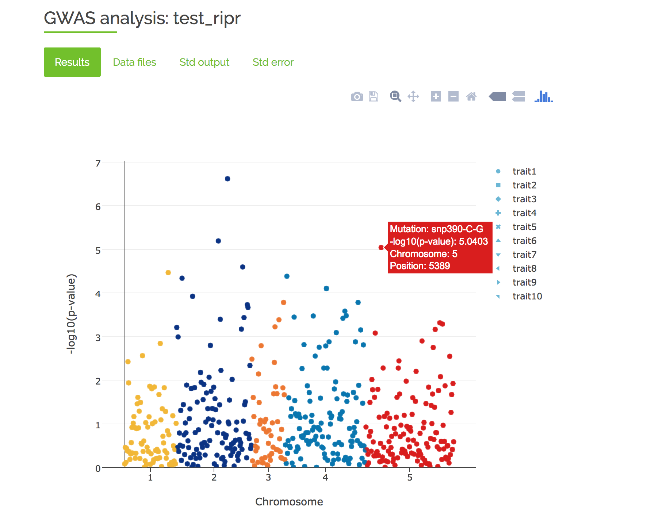

Slide 13
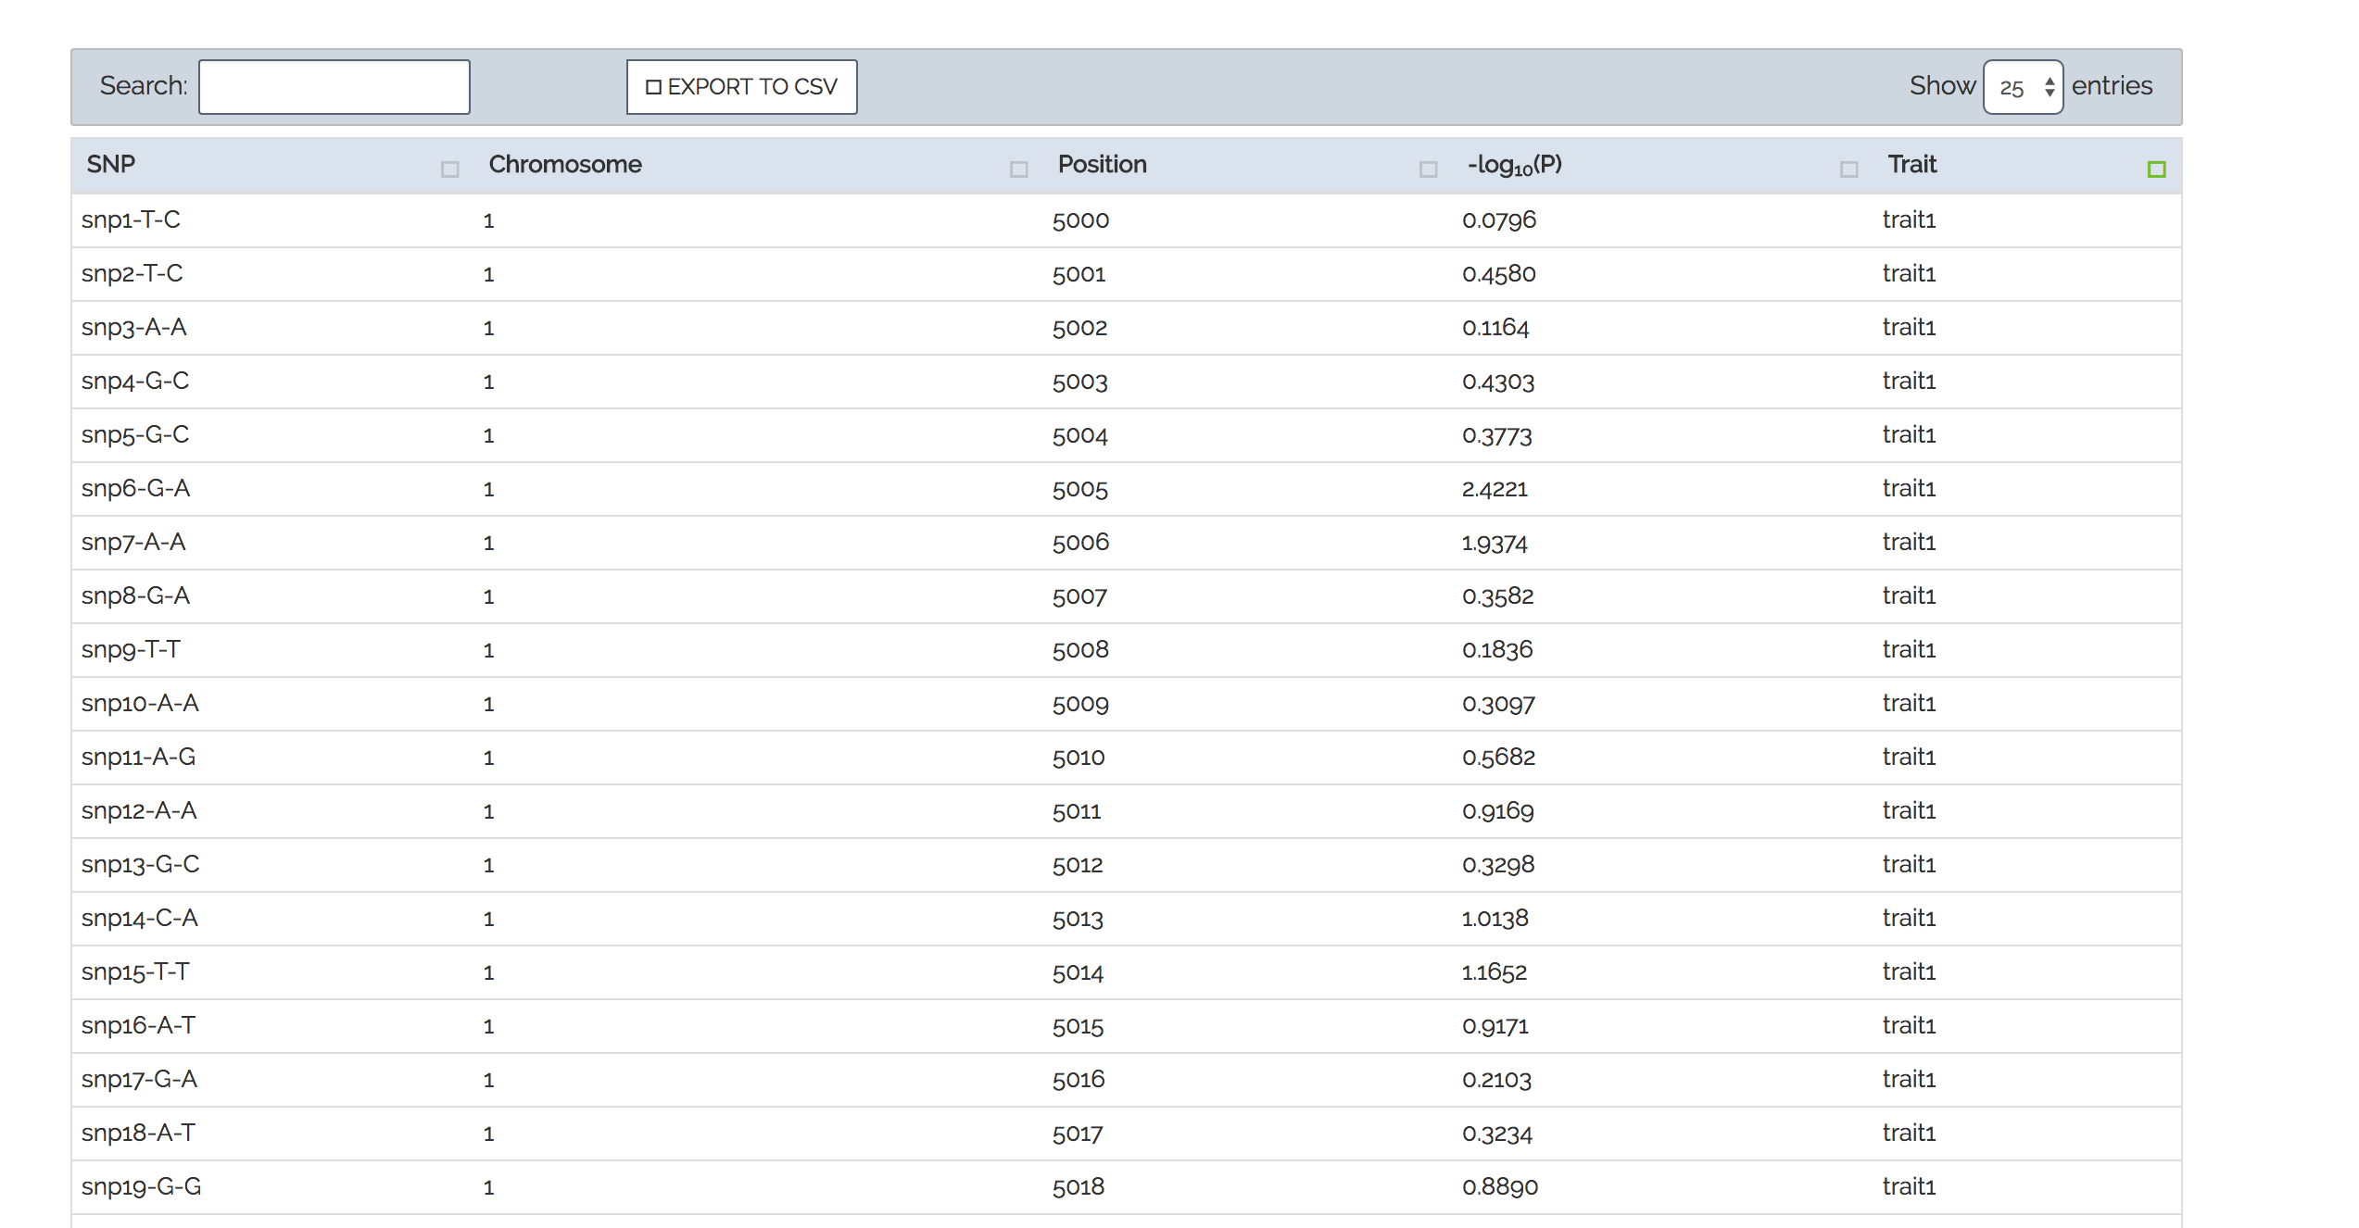

Slide 14
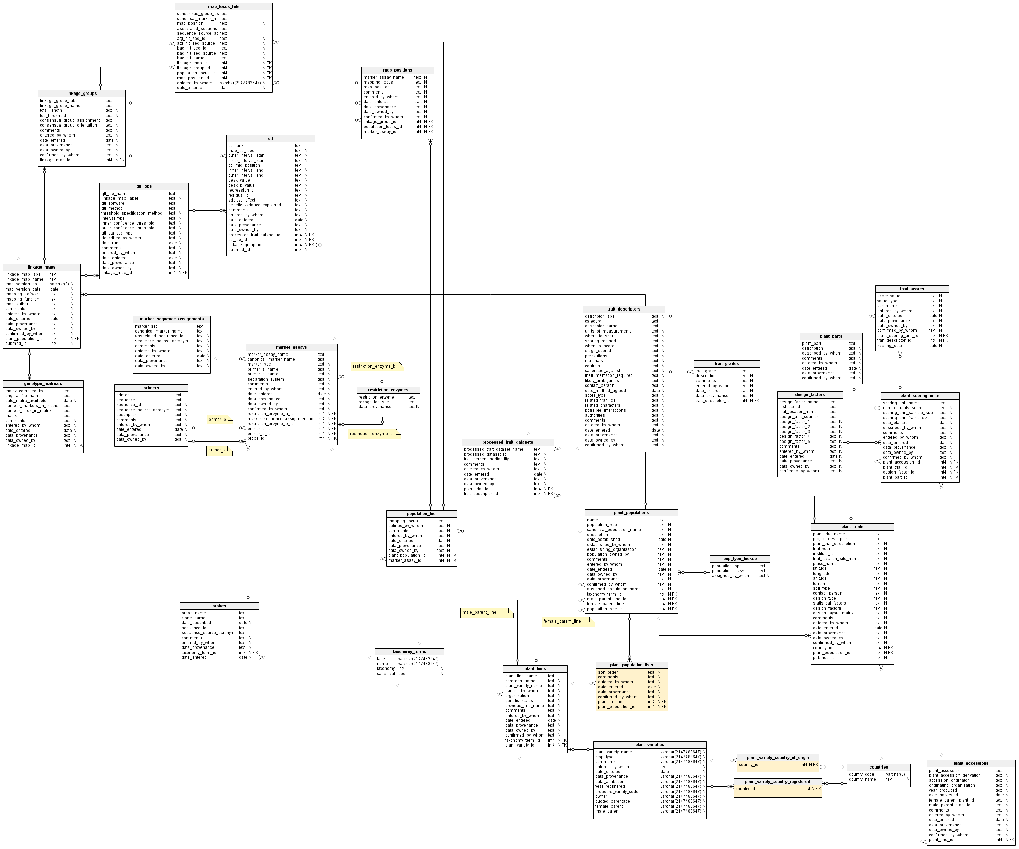
Data upload to BIP
The Brassica Information Portal interface and underlying schema
Notes:
Beneath the shiny web- interface is a complicated system of tables, that interact.

Slide 15
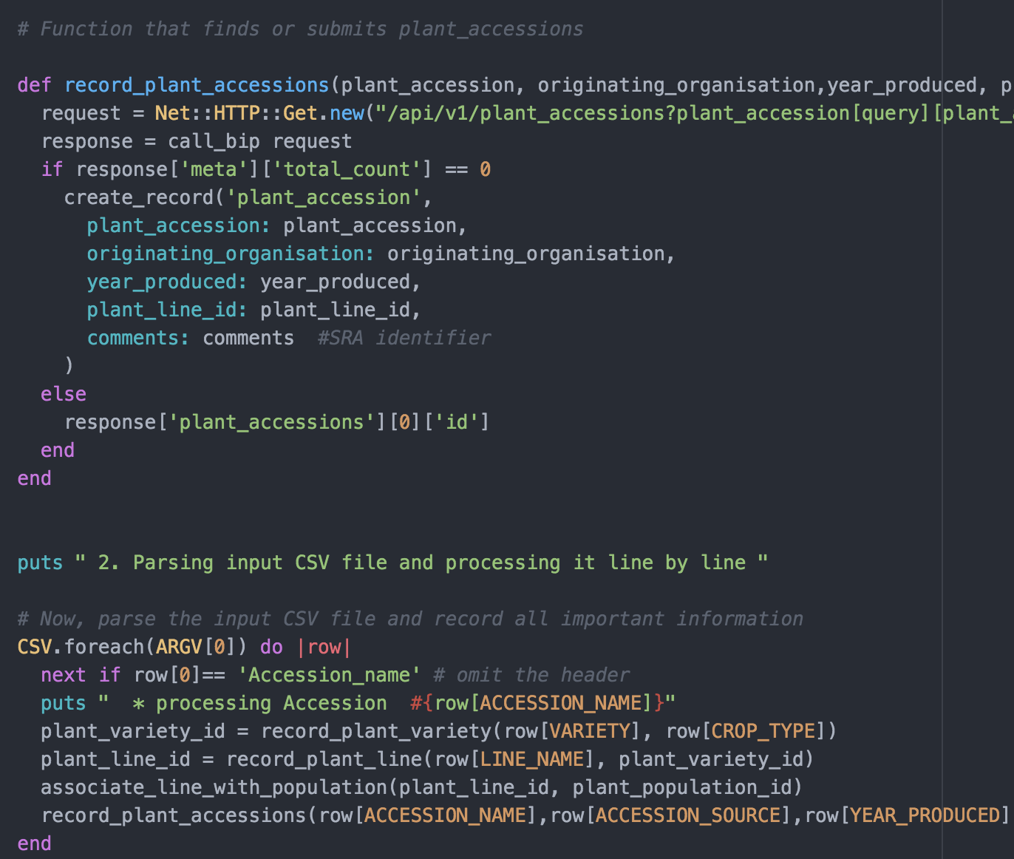
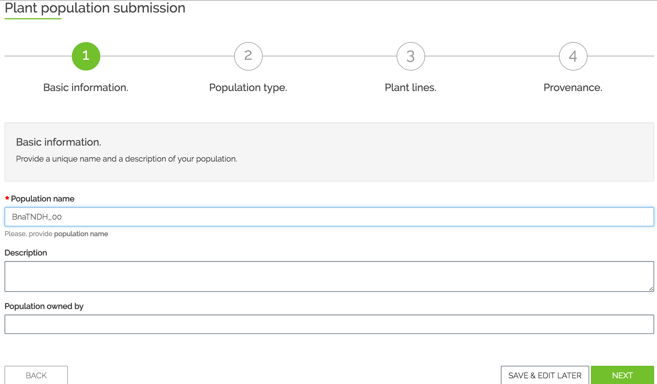
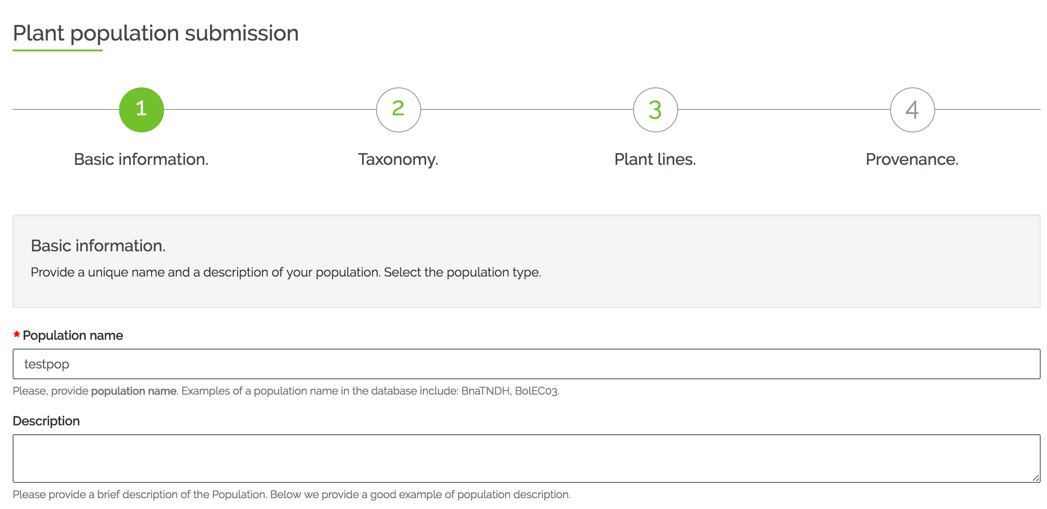
The BIP database schema
Trial Submission
Population Submission
Notes:
In this workshop , we are going to interact with these tables of the database

Slide 16
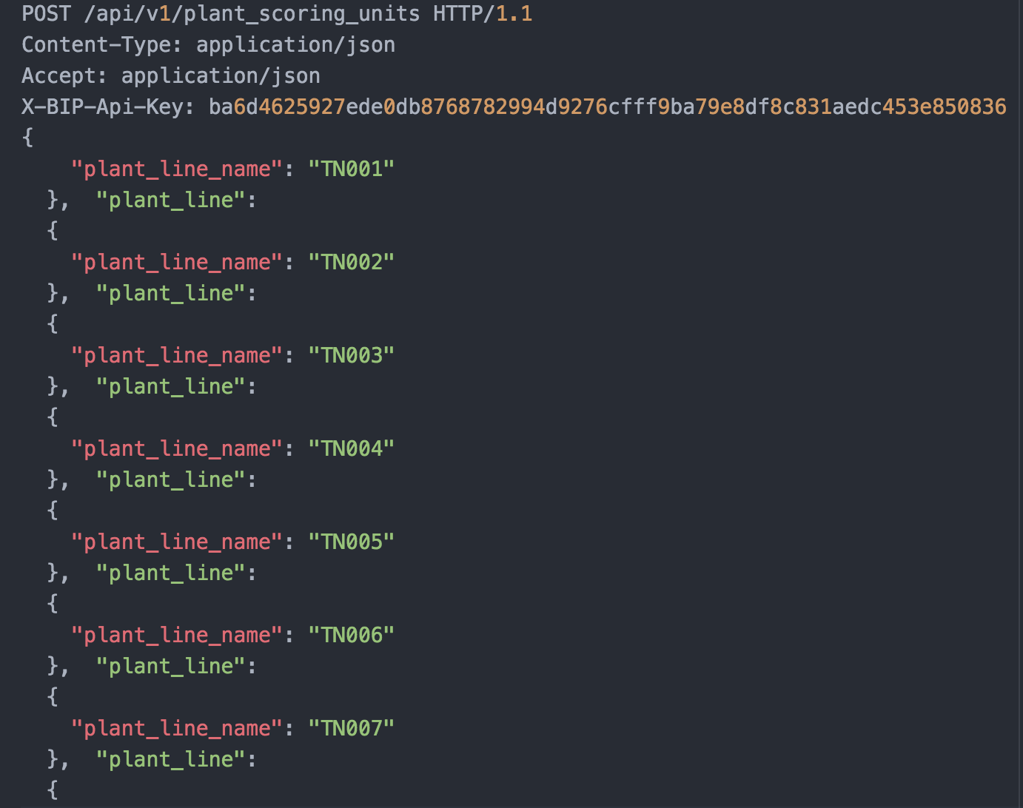
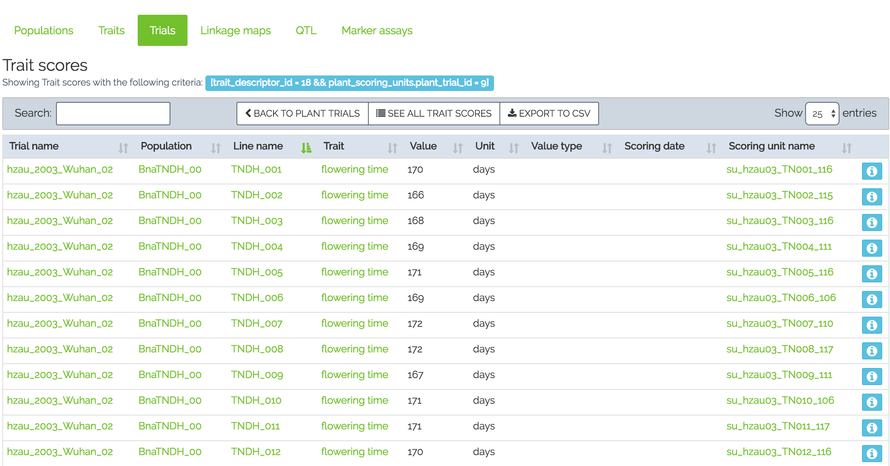
Different ways to communicate with the BIP
Programmatic submission
API layer
Web layer
Wizard based submission
HTTPS
Notes:
in the Population submission, we will interact programmatically ,and in the Trial submission, we will interact with the database using the schema.

Slide 17
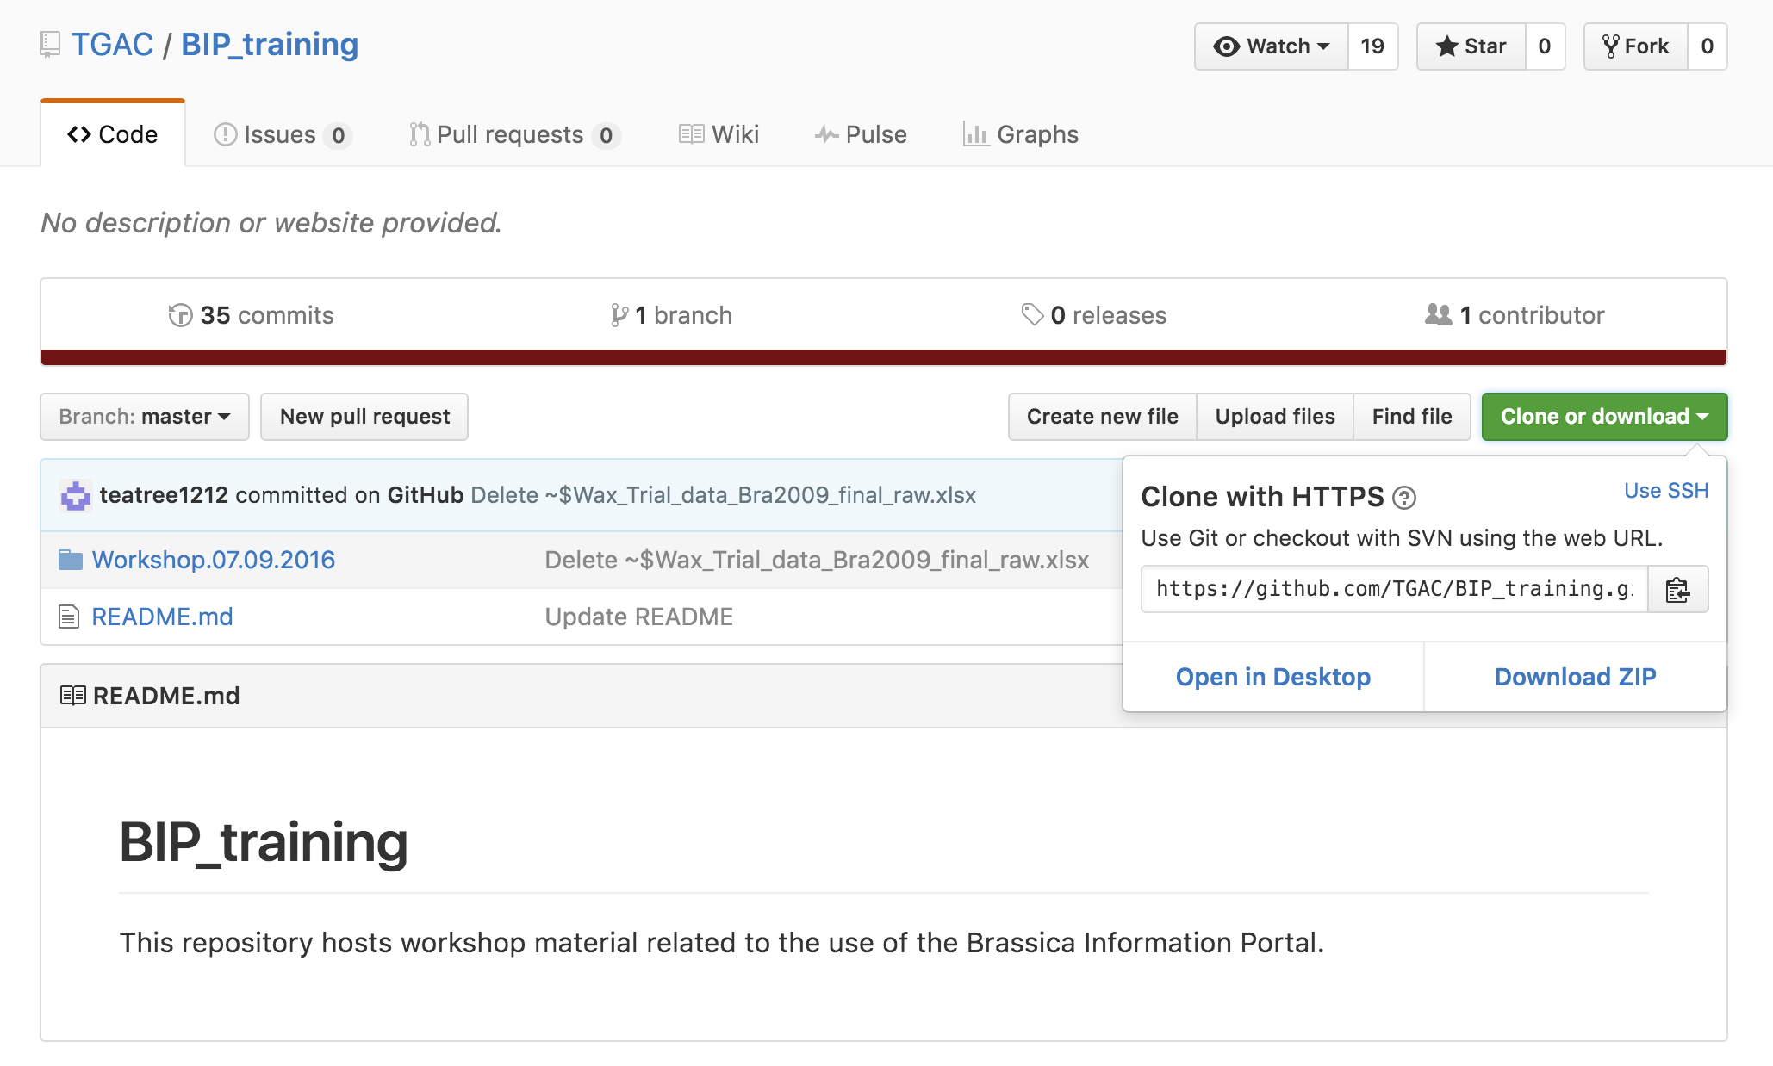
Access to workshop material
Please follow the link https://github.com/TGAC/BIP_training.
If you have any feedback (good or bad), write it on post-its provided.
Notes:
Workshop manual should also be printed. The data we work with is available on github. Clone the repo as shown on the screenshot.

Slide 18
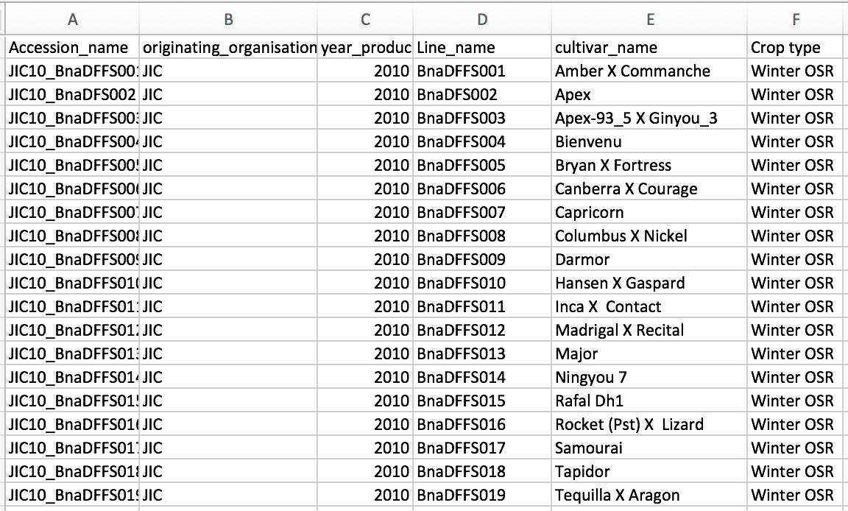
Population Submission
Population metadata
Brassica napus Diversity fixed foundation set -> line names
Seed bulked up at JIC in 2010
Assign identifier to the germplasm used
Nomenclature for Accession: <Institute abbr.><YY>_<line name>
FILE: 1_BnaDFFS.csv
Notes:
During this workshop we will be using mock-datasets , with Line and cultivar names from a Diversity fixed foundation set established in 2009.
Imagine, you have retrieved some seeds from that set for an experiment.
The mock data on the slide shows that the seed for the experiment has been bulked up at JIC in 2009.
Other mock data has ben bulked in 2010 or at Rothamsted or Nottingham in other years.
In order to account for the Genetic drift/ selection/ cross-pollination/other problems could happen during bulking,
the material may not be as “clean” as one thinks. Therefore, the accessions in the BIP are there to record this. Accessions are derived from the Institute where they have been bulked, the year they have been bulked, and the line name the seed originally came from.

Slide 19
Population submission
Population Submission using the wizard. Go to bip.earlham.ac.uk
Notes:
In order to submit the experimental population data, we go to bip.earlham.ac.uk, login and select population submission- START!
I will do it myself while you work on it.

Slide 20
Break
Any questions so far?
Give feedback over coffee
and tweet: @BrassicaP

Slide 21
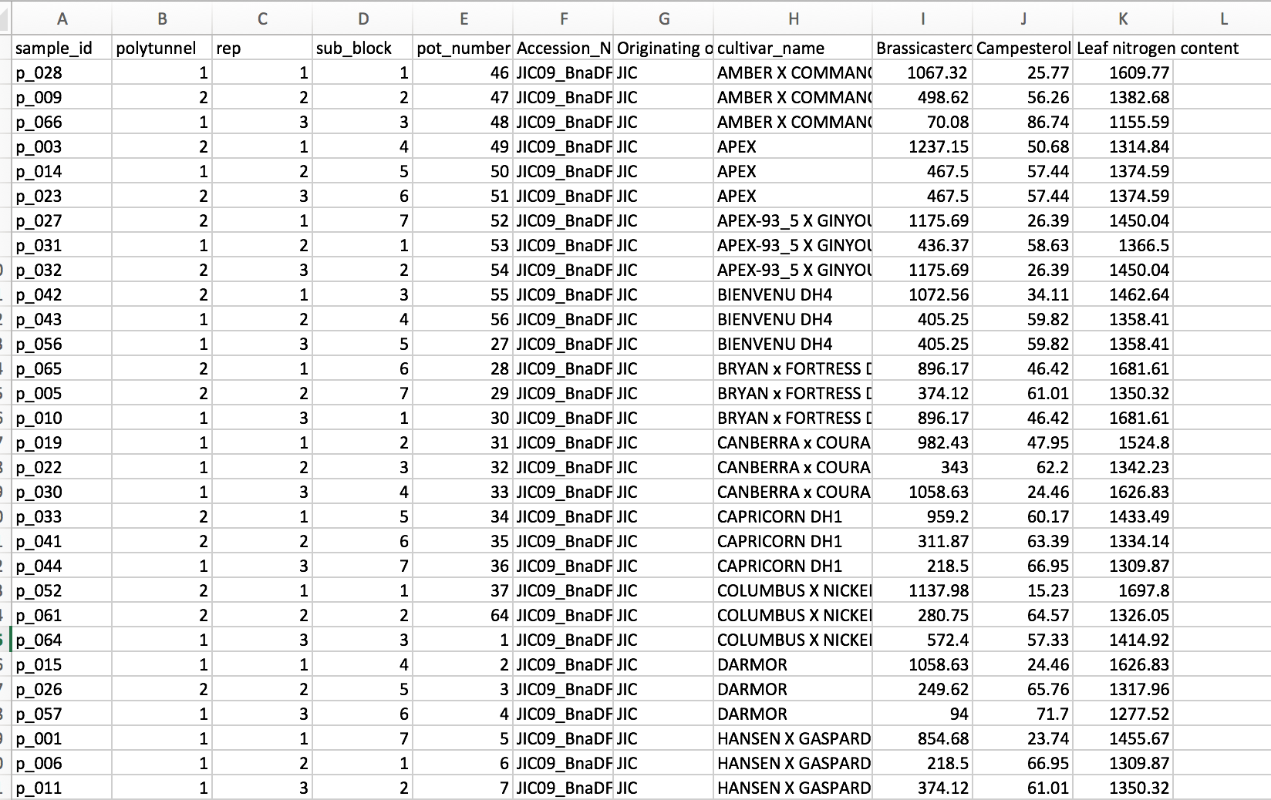
Triat data submission
19 Accessions
2 polytunnels, 3 reps, sub-blocks, pots
Morphological and biochemical traits measured
Files 2_Trial_data_biochem
2_Trial_data_morph
Notes:
Each group of 2 has a trial data sheet each to work with
Chose among you and your partner which sheet you would like to submit- they are marked by 3_
-
You see that this is raw data that is going to be submitted to the BIP. You can see the experimental design, sample_id, cultivar information, and the traits that have been measured.

Slide 22
Trial data submission
Trial Submission using the wizard. Go to bip.earlham.ac.uk
Notes:
In order to submit trial data, we go to bip.earlham.ac.uk, login and select trial submission- START!
I will do it myself while you work on it.

Slide 23
Parallel sessions
Bring Your Own Data
Help to improve the Population submission https://docs.google.com/spreadsheets/d/1xJlH7jQm8TWhA6DCVAKAdqwlEXoJNyRzWImoh6e_6OI/edit?usp=sharing
Revise mapping of BIP data model on MIAPPE

Slide 24
Eckes A. et al., F1000, 2017
Features
Feedback
User experience
Bugs
BIP framework can be reused for other crops!
Framework: github.com/TGAC/brassica
Documentation: bip.earlham.ac.uk
Training materials with use case: github.com/TGAC/BIP_training

Slide 25






Ian Bancroft
Lenka Havlickowa
Zhesi He
Ian Wood
RIPR and OREGIN
Annemarie Eckes
Tomasz Gubała
Piotr Nowakowski
Tomek Szymczyszyn
Bartosz Chucherko
Chris Rawlings
Rachel Wells Judith Irwin
Graham King
Abdul Baten
Sadaf Naz
John Hancock
Carlos Horro
Sarah Ayling
Tim Stitt
Anil Thanki
Robert Davey
Erik Van den Bergh
Ramona Walls
Elisabeth Arnaud, Cyril Pommier, Sophie Durand INRA
Hanna Ćwiek, Paweł Krajewski TransPlant
Notes:
Thank-you slide:
Thank the Collaborators- not Biologists

Slide 26
Thank you for attending!
Follow us on Twitter: @BrassicaPortal
Get in touch: bip@earlham.ac.uk

